Slide 1



Balanced Score Card
By
Himani Patel

Slide 2
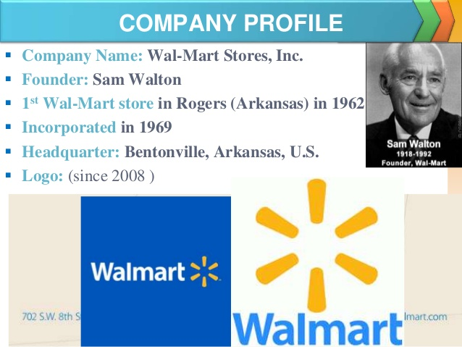
Walmart Profile

Slide 3
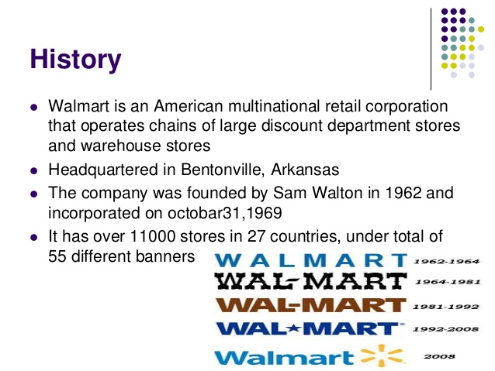

Walmart History

Slide 4
Generic information about balanced score card:
The Balanced Score Card (BSC) is strategic planning and management system that organization use to:
Communication what they are trying accomplish
The day-to-day work that everyone is doing strategy
Involves Projects, products and services
Measure and monitor progress towards strategic targets
“Balanced score card” comes from the idea of viewing at strategic measures in addition to traditional financial measures to collect a more “balanced” view of performance. The Balanced score card has evolved beyond the simple use of perspective and it is now a comprehensive system for managing strategy. A benefit of using a good framework is gives an organization a way to connect the dots between the various components of “strategic planning” and “management”. There will be a visible connection between the projects and programs that people are working on, on measurements being used to track success, the strategic objectives of the organization is trying to accomplish and the mission, vision and strategy of the organization. “The balanced score card retains traditional financial measures. But financial measures tell the story of the past event, an adequate story for industrial age companies for which investments in long-term capabilities and customer relationships were not critical for success. The financial measures are inadequate, for guiding and evaluating the journey that information age companies must take to create future value through investment in customers, suppliers ,employees, processes, technology and innovation”. In the case of Wal-Mart it helps communicate objectives in each area and enables the company to focus on those areas. The balanced score card approach helps convert strategy into action. This is necessary if the results are to be achieved. The efforts and actions of the firm are measured and are evaluated against industry standards. The measures and targets in the balanced score card approach enable Wal-Mart to compare its performance with that of industry.

Slide 5
Generic Information about Balanced Score Card
Balanced scorecard provides a framework to a company which helps in measuring company’s performance not only based on financial measures but also on the base of other non-financial measures such as Customer, Internal Business Processes and Learning and Growth. The concept was developed by Robert Kaplan and David Norton.
Kaplan & Norton (1996) Specified the outcomes included in Financial Performance, Customers, Internal Business Processes and Learning and growth can act as drivers of performance. The application for Wal-Mart can be discussed as Under:
Development of Infrastructure of Wal-Mart which includes establishment of retail stores and strengthening of cold storage and other supply chain infrastructure which will lead to organizational learning and growth.
This will lead to improvement in company’s internal business processes of Wal-Mart with technological facilitation.
This will further lead to improvement in customer satisfaction and retention of profitable customer
This will lead to further improvement in financial measures such as improved Return on Investment or Capital Employed, Profitability, new sales or market share.

Slide 6

Walmart Vision
Walmart vision statement is “Be the destination for customers to save money. No matter how they want to shop". The vision statement echoes the central reasons behind the desire of the company to position itself as the retail leaders. In relation to this vision statement, the following components come out:
Affordability
Convenience
Customer-oriented
Walmart recognizes the impact cost has in the retail sector, and that is one of the primary reasons it goes out of its way to attach competitive prices to all its products and services. In fact, its exploits this approach in its progress towards the achievement of its vision.
The affordability concept is widely captured in the pricing of the products in the Walmart stores. The strategic positioning adopted by Wal-Mart closely relates to its first component, while at the same time advancing its need to satisfy the needs of the second component in its vision statement. In explains the reason Wal-Mart is known as an international retainer owing to its global reach that meets the customer desire for convenience.
Wal-Mart particularly values tailoring all its services to comply with its third component that seeks to meet all customer preferences. In fact, its organizational and strategic positioning talk volumes about the commitment of the company towards meeting this component.

Slide 7
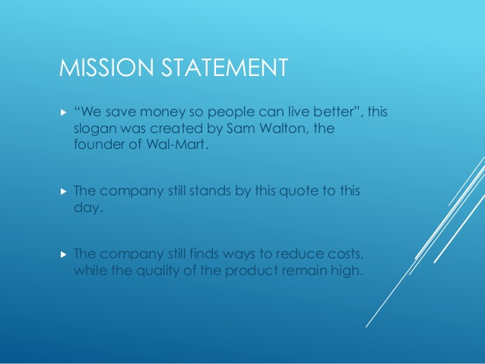
Walmart Mission

Slide 8
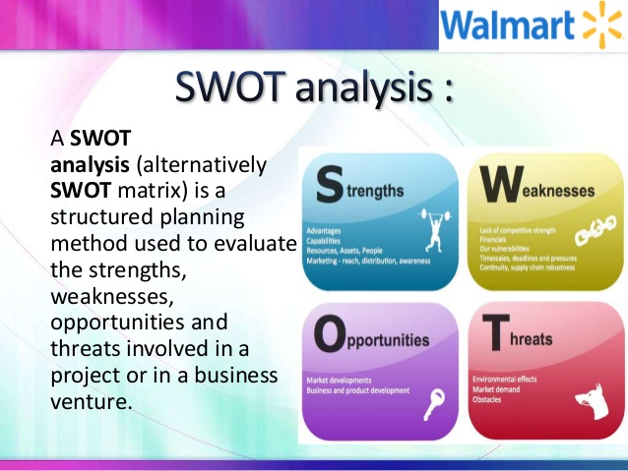
SWOT ANALYSIS:

Slide 9
Walmart’s Strengths:
Global Expansion: Walmart has recently purchased ASDA, the UK based retailer and Indian e-commerce gain Flipkart. Besides, it has created a joint venture with India’s biggest retail store Bharti. These global expansions have proven to be a great success for the company.
Global Presence: In 2007, Walmart opened 47 new stores in central America, 15 in chile, 11 in the UK and 4 in china. Its international operations have increased its sales and global presence.
Every Day Low Prices Strategy: Walmart is based on economies of scale agenda that’s why it can offer low prices. It has fixed costs for thousands of products. Thus, it’s one of the cheapest shopping places in the world.
Brand recognition: With millions of customers visiting Walmart every day, it is the most recognized retail brand in the world. There are over 60 million items available at the Walmart online store.
Walmart’s Weaknesses:
Thin profit margins: Walmart focuses on a cost leadership strategy. It results in thin profit margins for the company.
Imitation: Walmart’s business model can be easily copied. The company doesn’t own any specific competitive edge over its rivals except its huge business size.
Large span of control: Its highly extended size and massive span of control could leave Walmart weak in some areas.
SWOT ANALYSIS:

Slide 10
Walmart’s Opportunities:
Improving Quality Standards: Low- cost products render low quality sometimes. Walmart has the opportunity to enhance the quality standards of its products to address the health concerns of consumers.
Strategic alliances: Walmart has the opportunity to create strategic partnerships with major firms or merge with other global retailers. Acquisitions for small companies can also be a profitable opportunity for Walmart.
Expansion to other markets: Walmart can gain the opportunity by expanding its business to the markets which are not yet ventured. These may include china, Middle East countries, and Latin America.
Walmart’s Threats:
Political and legal Issues: This is also threat to political and legal affairs can always hinder the company to operate in some countries.
Technical issues on the website: Customers have complained many times that there are some technical issues with Walmart’s website. The products are not listed in an organized way on the website, and it runs slowly. However, Amazon is known for its fast, effective, and organized website, making an excellent online shopping experience for customers.
A primary target of competition: The world’s largest grocery retailer, Walmart is always a primary target for competitors. Target, its direct competitors, offers similar products but with higher quality. Similarly, Costco offers customers to buy items in bulk. Additionally, These companies have a relatively good reputation for treating their employees well compared to Walmart. Both companies are also publicly supported in these areas.
SWOT ANALYSIS

Slide 11
HOW TO UTILIZEBALANCED SCORE CARD?
Build Your Purpose Statement:
A Purpose Statement clearly communications how you'll be different than your competitors, and it should include three different aspects: Objective + Advantage + Scope. Put simply your purpose statement tell the world what you’re going to do (your objective), how you’re going to win (your advantage), and where you’re going to do it(your scope).
Design Your Change Agenda:
If the purpose statement looks outward, the change agenda looks inward. What do you need to make better in your organization to achieve your purpose statement? What levers can you pull to drive change? Your change agenda is a simple graphical representation of the changes that will occur in your organization as you execute strategy.
Make a Map:
Without a map to guide you to your destination, it’s very easy to make lots of wrong turns on your way to strategy execution. A strategy map is a simple, one-page visual representation of your strategic objective, with cause and effect linkage. It paints a picture of your strategy so everyone can understand it.

Slide 12
HOW TO UTILIZEBALANCED SCORE CARD?
Create Great Measures:
Once you have your map, it’s time to think about measures. Measures do two things: They help you manage (understand what’s not working) and they help you motivate (people respond to what’s being measured, even if there’s not compensation tied to it.) Choose the measures that help you drive your strategy.
Launch Some Initiatives:
Initiatives (or projects in regular-person speak) are where your strategy comes to life. What projects do you need to kick off in order to execute this strategy? And, just as important, what things are you going to stop doing in order to focus on your strategy? Keep a close eye on these projects as they will drive your success.

Slide 13
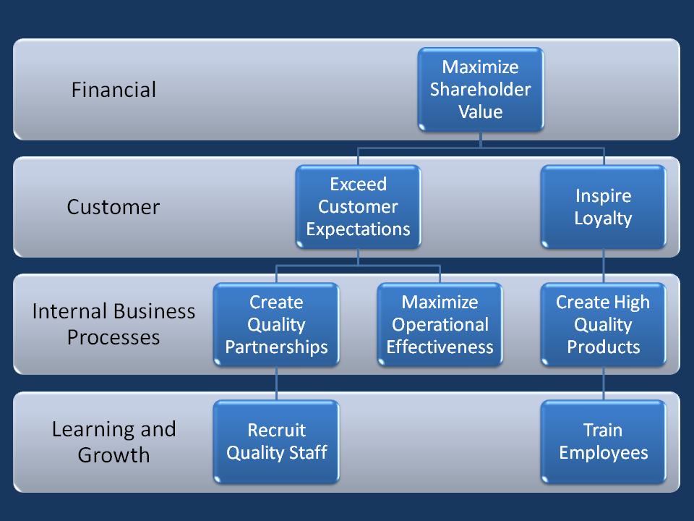
Strategy performance

Slide 14
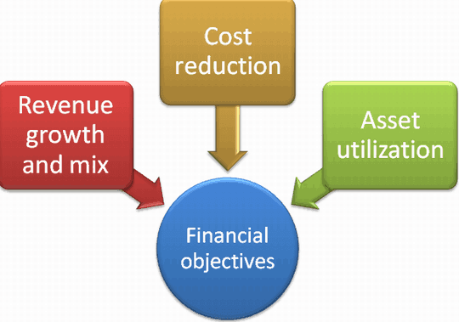
Financial Perspective
Kaplan and Norton do not disregard the traditional need for financial data. Timely and accurate funding data will always be a priority, and managers will make sure to provide it. There is often more than sufficient handling and processing of financial data. With the implementation of a corporate database, it is hoped that more of the processing can be centralized and automated. But the point is that the current emphasis on financial issues leads to an unbalanced situation with regard to other perspective. There is perhaps a need to include additional financial related data, Such as risk assessment and cost-benefit data, in this category.

Slide 15
The major financial performance measures would be:
Market Share: As Wal-Mart is losing market share to not only major competitors such as Target Corporation but also to small players and online retailers, one major financial goal will be to improve market share by going more aggressive pricing the products below competition by bringing more efficiencies in supply chain.
Return on Investment (ROI): Wal-Mart’s return on investment has improved to 25% in 2011 as compared to 20% in 2002 (Seeking Alpha, 2012: Nd). This is a resultant of its aggressive marketing strategies.
Trade-off between market share and profitability: The company may have to trade-off between market share and profitability in the short run because selling at low prices may lead to some compromise on profitability.
Retail Sales per square feet: By focusing on convenience stores which will consume less expenditure, the net sales of the company could be increase by increasing the square feet of space, locating new retail stores by locating in new geographical areas or new international markets like India.
The common goal of any organization is always to improve its shareholder’s wealth as well as giving them some of their best quality services to their customers through the Wal-Mart new division. For purpose of sustaining growth Wal-Mart New divisions, the focus of the division should be focused on developing its market share in market that it serves (Caraway,2015). The division plans on the process of establishing new outlets in different locations to make its services better and efficient for the customers. Through the process of advertising both locally and digitally, the company will be in a position to create greater brand recognition that will eventually help in the process of generating higher organizational revenues.
Financial Perspective

Slide 16
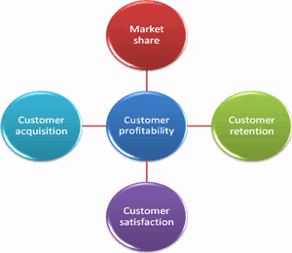
CUSTOMER PERSPECTIVE
Management philosophy has shown an increasing realization of the importance of customer focus and customer satisfaction in Wal-Mart Company. These are called leading indicators: If customers are not satisfied, they will eventually find other Grocery Store that will meet their needs. Poor performance from this perspective is thus a leading indicator of future decline. In developing metrics for satisfaction, customers should be analyzed. Timely processes for which we are providing a product or service to those customer groups.

Slide 17
Customer Perspective
We need to understand customer perspective where the company’s focus should be on retention of profitable customers. There was a startling revelation by ClickIQ Inc. in its research which stated that consumers prefer to purchase the products online but before that, they visit physical retail stores first. This is impacting the business of Wal-Mart as consumers do go for browsing through the products in retail store of Wal-Mart but actually purchase the products through online retailers. Although over a period Every Day Low prices (EDLP)but now other retailers are considered to be cheaper than Wal-Mart. And a lot of customers are shifting to other retail stores due to low prices.
The process of developing a positive experience happens to play a key role in the grand scheme of the whole strategic plans. From the fact that most of the division’s customers will be the common customers of the company, organizational sales will increase, as the customers will offer referrals to the division as a result of efficiency and effectiveness. For purposes of attracting new customers, the division will offer discount to all of its new customers while giving an incentive the old customers for purposes of letting the other groups of individuals aware of new division and the efficiency in the organization through the division. It is important to note that improving the loyalty of the customers happens to be amongst some of the important goal from the customer value perspective. It is important to note that a key social media communication channel will be used to market the division and its activities thus allowing for rapid communication within all customers. The other objectives will be to increase customer satisfaction, increase loyalty and increase customer retention.

Slide 18
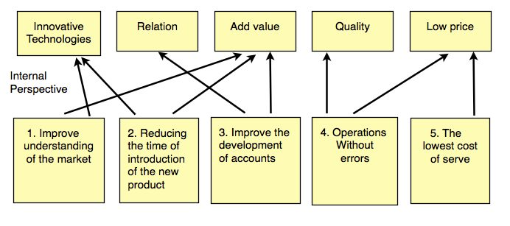
Business Process Perspective
It refers to international business processes. Measurement based on this perspective will show the managers hoe well their business is running, whether its product and services conform to customer requirements. Strategic management Process, two kinds of business processes may be identified:
Mission-Oriented Processes: Many unique problems are encountered in these processes.
Support Processes: The support processes are more repetitive in nature, and hence easier to measure and to benchmark. Generic measurement methods can be used.

Slide 19
the cThe improvement areas include
Developing convenience stores of a size below 30,000 sq. Ft. of floor area (Wal-Mart 2011 Annual report).
Bringing improvements in supply chain and logistics efficiencies in 2012-13 to sustain the Every Day Low Prices (EDLP Policy) of the company (Wal-Mart 2011 Annual Report).
Convenience store format will lead to reduction in shopping time for the consumer as right now at Dollar General retail stores, consumers spend only ten minutes to shop on the stores whereas it takes a lot of time to shop at Wal-Mart due to its huge size and parking lot.
Higher Visibility of merchandise in the store will lead to reduction in this time gap.
Outsourcing from low cost bases like Taiwan and china could least to cost competitiveness of the company.
New division supposed to come up with new ways of improving the internal operations for purposes of providing the capital that is needed to sustain the long-term growth the division. Wal-Mart new division has come up with a commitment on improving the return on assets ratio. All the equipment in the organization and division are supposed to be operating a peak performance for purposes of enabling the company to remain profitable. As a result of this, a detailed analysis of the organization’s assets will be carried. Wal-Mart is a global leader in the food industry and it will come up with one of the best and most effective ways of serving its customers. As the organization’s division grows, the process identified will give ompany an opportunity to position its prices lower than its competitors who offer the same services . New division will be to maximize on efficiency, streamline the installation procedures and reduce the go-backs.
Business Process Perspective

Slide 20
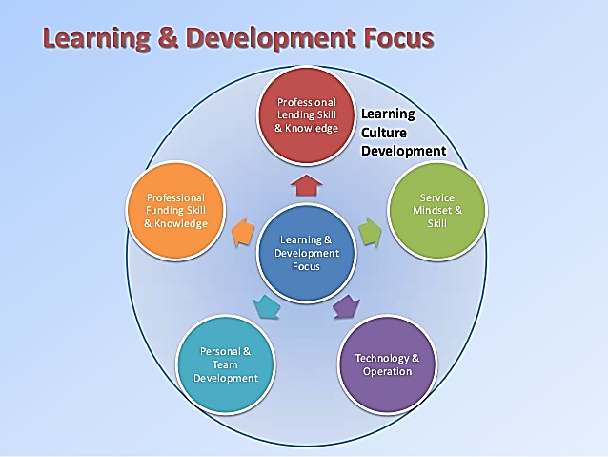
Learning And Growth Perspective
This Perspective includes employee training and corporate cultural attitudes related to both individual and corporate self improvement. In current climate of rapid technological, economic changes and new legislation and regulations, it is becoming necessary for knowledge workers to learn continuously. Government agencies find themselves unable to hire new technical workers and at the same time is showing a decline in training of existing employees. Kaplan and Norton emphasize that “learning” is something more than ‘training’; it also includes things like mentors and tutors within the organization, the communication among workers that allows them to readily get help on a problem when it is needed. It also includes technological tools such as an internet.

Slide 21
A company needs to continuously think of how to improve and create value for the customers(Kaplan & Norton, 1996:75).
The emphasis on learning and growth perspective of a company is the resultant of continuous improvement and this is being guided by the vision and mission statement. Therefore, we need to analyze the vision and mission. The mission statement and vision statement of Wal-Mart states that “We save people money so they can live better.” Wal-Mart envisions to be “Worldwide leader in retail.”
Now, to serve the vision and mission statement, we need to analyze what is happening at present which is leading Wal-Mart to serve this vision and mission. This is clear from the facts given below:
Recent Facts
Dollar General Stores are costing 7% less as compared to Wal-Mart’s stores (Marcial, 2011:29 December).
The products of Wal-Mart is believed to be costlier than online store Amazon, physical stores Dollar Tree and Family Dollar Stores.
The following table depicts some more facts about Wal-Mart:
As compared to Wal-Mart’s basket of 35 items, Target corporation has been able to keep prices at 0.7% less which is a resultant of outsourcing to low cost destinations and the result is evident from loss of market share of Wal-Mart .
Learning And Growth Perspective
S.No. | Retail Store | Same Store Sales Gain | Revenue Growth
1 | Wal-Mart | 2.4% | 5.8%
2 | Dollar Tree | 6.3% | 12.8%
3 | Dollar General Stores | 10% | 7.3%
4 | Costco Retail | 7% | 11.5%

Slide 22
Advantage of Balanced score card
It make it easy to communicate your strategy:
Strategy map is designed to clearly communicate a strategy plan. It is a clean, simple visual aid used to align every department or division for the purpose of achieving high-level business goals. When implemented correctly, it:
Allows employees to better understand the strategic elements that need work.
Gives employees clear goals to keep in mind while working on measures.
Enables employees to see how objectives affect one another.
Helps employees identify key goals.
2) It keeps your strategy front and center of your reporting process:
A lot of organizations build strategic plans and put them on a shelf, never to be seen again. The creation of BSC is predicated on reviewing your strategy on a regular basis- Regular strategy review meetings on a monthly or quarterly basis, combined with an annual strategy refresh, will ensure you reference your strategy regularly and keep it at the center of your management reporting process. Review your strategy will helping you manage your organization. Which will you know where you are at all times in achieving your goals.

Slide 23
3) It gives structure to your strategy:
Organizations frequently talk about organizational performance in a verity of ways. Thus, there are many different approaches to strategic management. Balanced score card is logical, structured way to help the leaders of your organization ensure that all areas of the organization are covered in an easy-to-understand way.
4) It helps your employees see how their individual goals link to the organizational strategy:
Using strategy-focus organization framework, the BSC allows individuals to align their goals across the organization. For Example, an employee setting regular performance goals for an annual personal review can link their goals to those of their division or department. Thus, the BSC allows all of your employees to connect what they’re doing to the betterment of the team and the company as a whole.
5) It aligns your departments and divisions:
When implemented correctly, all divisions and departments should align with a common strategy, and the Balanced score card facilitates this process. With the BSC structure, you can link your critical objectives to the objectives of a parent company or enterprise. You can see how your measures may roll up to the enterprise-level measures, how projects link to enterprise-level project. The BSC also provides the structure needed when large projects are shared across multiple divisions.

Slide 24
Disadvantage of Balanced score card
It requires strong leadership support to be successful:
You may be having trouble with your score card because new leadership isn’t convinced that BSC is a viable option-or your existing leadership simply may not like or understand the structure. It’s important to remember that the BSC requires a total overhaul to the way you manage; it is not a project with a defined end date. If you’re asked to build a scorecard and then return to business as usual, be warned that your score carding process isn’t likely to work.
It can be an overwhelming framework:
In fact, it’s the largest topic on the Harvard Business Review- if you tried to read every single case study, you’d get bogged down quickly. If you try to jump in with Norton and Kaplan’s fifth book, you’re likely to get overwhelmed with how to move forward.
It can’t be copied precisely from examples:
Following what you just read, your strategy and example strategies you’ve read about will be different. You’ll be tempted to copy an example map, but keep in mind your strategy is entirely unique to you. We highly suggest using templates to get ideas of what over organizations using the BSC have done, but then step away and build
Something that is unique to you.

Slide 25
It may appear too rigid for the way you manage:
Sometimes transitioning to a balanced score card process can cause confusion within an organization. Rather than taking time to adapt, some leaders quickly decide to quit the BSC and return to their old ways. If you find yourself in these shoes- For example, trying to use the exact perspective names that Norton and Kaplan use while people in your organization don’t respond to those terms- you may find the BSC structure more cumbersome than it is worthwhile. Or, if you’re married to your current strategy review schedule despite a shakeup in management or a major change in strategy, that’s a problem.
It can be difficult to keep everyone on the same page:
Many organizations try to manage their score card in Excel or PowerPoint and end up throwing it away. Managing a BSC in Excel can lead to accuracy problems, vision control issues, and various Complexities and Formatting troubles, while Excel is a free tool, there are number of Hidden costs. When these things happen, leaders are likely to see the Balanced score card as the problem instead of the tool used to manage it.

Slide 26
References
https://balancedscorecard.org/bsc-basics-overview/
https://mission-statement.com/walmart/
https://www.clearpointstrategy.com/how-to-create-a-balanced-scorecard/
http://www.whatishumanresource.com/balanced-scorecard
https://www.clearpointstrategy.com/thorough-list-of-balanced-scorecard-advantages-disadvantages/
Kaplan R. & Norton D.P, 1996, Linking the Balanced Scorecard to Strategy , California Management Review, Vol. 39 No.1 pp 53-79, [Online], Retrieved from: http://cis.kaist.ac.kr/data/Linking%20BSC%20to%20Strategy.pdf
Marcial G., 2011, Discount Retailer Dollar General Taking Away market Share from No.1 Wal-Mart, [Online], Retrieved from: http://www.forbes.com/sites/genemarcial/2011/12/29/discount-retailer-dollar-general-taking-away-market-share-from-no-1-wal-mart/ [29 December 2011]

Slide 27
References
PR Web, 2012, Walmart and Target Retail Stores Give Amazon a brick and mortar footprint, [Online], Retrieved from: http://www.prweb.com/releases/2012/2/prweb9198954.htm [15 February 2012].
Welch D., 2012, Wal-Mart losing out to online retailers, [Online], Retrieved from: http://business.financialpost.com/2012/03/20/wal-mart-losing-out-to-online-retailers/ [20 March 2012].
Walmart, 2011, Annual Report, [Online], Retrieved from: http://walmartstores.com/sites/annualreport/2011/financials/walmart_2011_annual_report.pdf [Accessed on 3rd April 2012]
Kharif O., 2010, Wal-Mart picks up Digital VUDU, [Online], Retrieved from: http://www.businessweek.com/technology/content/feb2010/tc20100222_235241.htm [22 Feb 2010].
http://www.oslocraftsmarket.com/educational-essays/2018/strategic-plan-balanced-scorecard-walmart/
https://bstrategyhub.com/swot-analysis-of-walmart-2019-walmart-swot-analysis/

